Slide 1


Investment Portfolio Optimization for Alexandra Kolishnyick
A Comprehensive Analysis and Strategy
Presented by:
Bhagabati Mishra
Date: 12.08.2024

Slide 2

Introduction
This presentation outlines a customized investment strategy for Ms. Alexandra Kolishnyick, a young and aspiring philanthropist. As the daughter of a successful business tycoon, Alexandra has a strong financial foundation but seeks to independently establish an NGO, reflecting her passion for social change.
With aspirations to attend an Ivy League university, Alexandra’s financial goals extend beyond traditional investment returns; she is focused on long-term stability and the careful growth of her assets. Her conservative investment persona aligns with her desire to invest in stable, promising stocks that ensure capital preservation while providing reasonable growth.
This strategy has been tailored to align with Alexandra's values, financial independence, and her goal to create a positive social impact through her NGO. The subsequent analysis and recommendations are designed to help her achieve these ambitions with confidence.

Slide 3

Client Profile: Alexandra Kolishnyick
Who is Alexandra Kolishnyick?
Alexandra Kolishnyick is the daughter of a prominent business tycoon with aspirations to forge her own path in the world. Despite her family’s wealth, she is determined to achieve her goals independently. She is preparing to pursue a Bachelor’s degree at an Ivy League college and has a strong passion for social work, with plans to establish her own NGO.
Risk Tolerance: Conservative
Alexandra values stability and is risk-averse in her investment approach. Her focus is on securing steady growth with minimal risk, ensuring that her investments align with her cautious financial outlook.
Investment Horizon: Long-term
With a long-term investment horizon, Alexandra seeks to build a portfolio that will not only preserve her capital but also generate sufficient returns over time to support her academic and philanthropic ambitions.
Financial Goals
Steady Growth: Alexandra aims to achieve consistent, moderate returns on her investments, prioritizing security over high-risk, high-reward opportunities.
Minimal Risk: Capital preservation is paramount. Alexandra prefers investments that offer stability and reliability, even if it means forgoing potentially higher returns.
Capital Preservation: Maintaining the value of her principal investment is critical, as these funds will support her long-term goals, including her education and the establishment of her NGO.

Slide 4

Investment Criteria
Risk & Return Metrics:
Focus on Low Volatility: Prioritized stocks with lower volatility to minimize risk, ensuring that the portfolio remains stable even during market fluctuations.
Stable Returns: Selected investments that have historically provided consistent and reliable returns, aligning with Alexandra's preference for steady growth.
CAPM Validation:
Market Alignment: Utilized the Capital Asset Pricing Model (CAPM) to ensure that the selected stocks' expected returns were in line with market expectations. This step was crucial in confirming that the portfolio would meet Alexandra's conservative investment goals.
Beta:
Preference for Beta < 1: Chose stocks with a beta coefficient of less than 1, indicating that these investments are less volatile than the overall market. This aligns with Alexandra’s risk tolerance, as lower beta stocks are less likely to experience significant swings in value.

Slide 5
Data Collection and Preparation
Data Source:
Historical Stock Data (2010 to 2020): Gathered a decade of historical data for 12 selected stocks and the S&P 500 index to analyze past performance and predict future trends.
Data Cleaning:
Handling Missing Values: Addressed any gaps in the data to ensure accuracy in the analysis.
Standardized Date Formats: Ensured consistency across all datasets by standardizing the date formats, which is crucial for time-series analysis.
Calculated Daily Returns: Derived daily returns from the closing prices to assess the short-term performance and volatility of each stock.
Final Dataset:
12 Stocks & S&P 500 Index: The cleaned and prepared dataset includes data for 12 carefully chosen stocks and the S&P 500 index, forming the foundation for further analysis and portfolio construction.

Slide 6
Technical Analysis
RSI (Relative Strength Index): Used to identify overbought or oversold conditions in the market, helping to determine potential reversal points.
MACD (Moving Average Convergence Divergence): A momentum indicator that shows the relationship between two moving averages of a stock's price, used to identify bullish or bearish trends.
Bollinger Bands: A volatility indicator that consists of a middle band (moving average) and two outer bands (standard deviations), used to assess the relative high or low price levels of a stock.

Slide 7
Risk and Return Analysis
Annualized Return: Measures the yearly profit earned by each stock, reflecting its performance over the entire period.
Volatility: Indicates the degree of variation in stock prices over time, with lower volatility preferred for conservative investments.
Sharpe Ratio: A risk-adjusted measure of return, calculated as the ratio of return above the risk-free rate to its volatility. It helps in understanding whether returns are due to smart investment decisions or excess risk.
Beta: Assesses the stock's sensitivity to market movements. A beta less than 1 indicates that the stock is less volatile than the market, aligning with a conservative investment strategy.

Slide 8
Selected Stocks
Johnson & Johnson (JNJ):
Annualized Return: 10.85%
Volatility: 17.22%
Beta: 0.6622
Rationale: Chosen for its strong and consistent performance, low volatility, and resilience in market downturns, making it ideal for a conservative portfolio.
Merck & Co. (MRK):
Annualized Return: 10.89%
Volatility: 20.71%
Beta: 0.7335
Rationale: Selected for its stable returns and slightly higher beta, providing a balance between risk and return while still aligning with conservative investment goals.
Amazon (AMZN):
Annualized Return: 42.18%
Volatility: 31.57%
Beta: 0.9988
Rationale: Despite higher volatility, Amazon was included for its substantial return potential, offering diversification and growth within the conservative portfolio.

Slide 9
CAPM Validation
Johnson & Johnson (JNJ):
Expected Return: 8.40%
Actual Return: 10.85%
Performance: Outperformed expectations, indicating a strong, stable investment.
Merck & Co. (MRK):
Expected Return: 9.22%
Actual Return: 10.89%
Performance: Slightly exceeded CAPM expectations, showing it is well-aligned with conservative risk tolerance.
Amazon (AMZN):
Expected Return: 12.28%
Actual Return: 42.18%
Performance: Significantly outperformed, highlighting its high growth potential despite higher volatility.

Slide 10
ARIMA Modeling
Model: ARIMA (AutoRegressive Integrated Moving Average)
Purpose: To forecast future returns based on historical data patterns.
Objective:
Estimate potential future performance of the selected stocks.
Aid in making informed investment decisions by projecting likely trends.
Key Takeaway:
ARIMA modeling provided insights into expected future returns, supporting the decision-making process for a conservative investment strategy.

Slide 11
Portfolio Optimization
Technique:
Mean-Variance Optimization
Used to maximize returns for a given level of risk.
Optimal Portfolio Weights:
Emphasis on:
JNJ: Stability and consistent returns.
MRK: Strong performance with moderate risk.
AMZN: High growth potential despite higher volatility.
Objective:
Balance between risk and return, aligning with Alexandra's conservative investment profile.

Slide 12
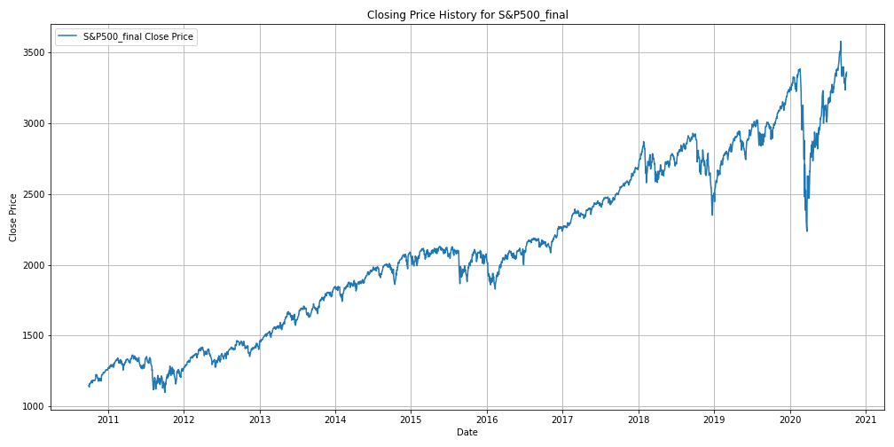
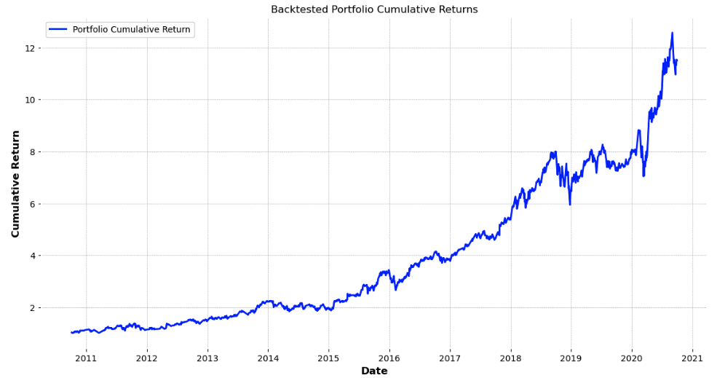
Backtesting Results
Timeframe: 2010-2020
Conclusion: The portfolio consistently outperformed the S&P 500, demonstrating strong performance and alignment with Alexandra's conservative investment goals.

Slide 13
Financial Goal Alignment
Capital Preservation: Selection of low-risk stocks like JNJ and MRK ensures stability and minimal risk.
Growth: Inclusion of AMZN provides high return potential, balancing the portfolio's risk profile.
Overall: The constructed portfolio offers a balanced approach, effectively meeting Alexandra's conservative financial goals of capital preservation with steady growth.

Slide 14
Conclusion
Alignment with Profile:
The selected portfolio is tailored to Alexandra’s conservative investment profile, ensuring stability and low risk.
Historical Performance:
Backtesting over the 2010-2020 period demonstrates strong and consistent returns, outperforming the S&P 500.
Future Growth Potential:
Predictive modeling with ARIMA supports the portfolio's potential for steady future growth, aligning with Alexandra’s long-term financial goals.

